Slide 1



Discussions

Slide 2

Definitions/Acronyms:
Term/Acronym | Definition
A-SPICE | Automotive Software Process Improvement and Capability Determination
SYS | System Engineering
SWE | Software Engineering
Workflow | Definition, execution and automation of business processes where tasks, information or documents are passed from one participant to another for action, according to a set of procedural rules.
Trace | Link between two meaningful contents in a document

Slide 3
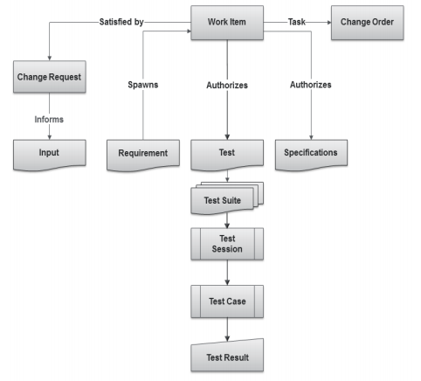
What Are Items?
  Items are the basic building blocks of the Integrity data model, and represent the information assets and process objects associated with software development.
  For example, items can represent Work items, projects, requirements, test cases, change requests, and defects.
  Every item is configurable and contains metadata and history about that item.
  Every item type has its own enforceable workflow which describes how it moves from state to state, complete with definable rules, full audit trails, and security.
  Escalations, conditional assignments, notifications, and external processes can all be defined and initiated as part of Integrity’s process automation

Slide 4
Creating Discussion

Slide 5
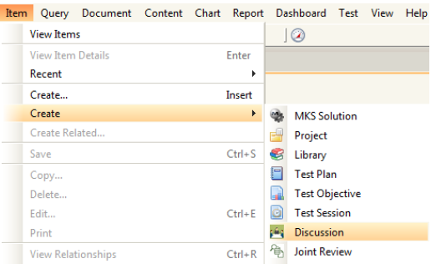
Creating a Discussion
Select Create in Item menu to create a new Discussion Item in Integrity.
Steps:
1.Creating Discussion
2.Editing data in Item view
3.Applying changes in created item
4.Item Details View
5.Discussion Workflow

Slide 6
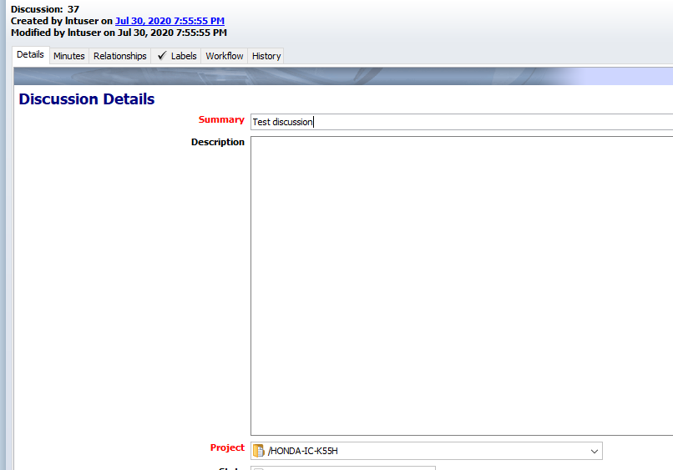
Creating a Discussion
Item details view will open up. Enter or select correct values for the fields present. Enter values in all fields. Mandatory fields are marked Red.
Steps:
1.Creating Discussion
2.Editing data in Item view
3.Applying changes in created item
4.Item Details View
5.Discussion Workflow

Slide 7
Creating a Discussion
All other fields visible in the Item Details view must be filled.
Clicking on “Apply” will keep the user on the same screen while clicking on “OK” will show the user a non-editable form-like view.
Clicking “Apply” will save the document. Alternately “Ctrl + S” can also be used.
Click on “OK” to finish creating.
Steps:
1.Creating Discussion
2.Editing data in Item view
3.Applying changes in created item
4.Item Details View
5.Discussion Workflow

Slide 8
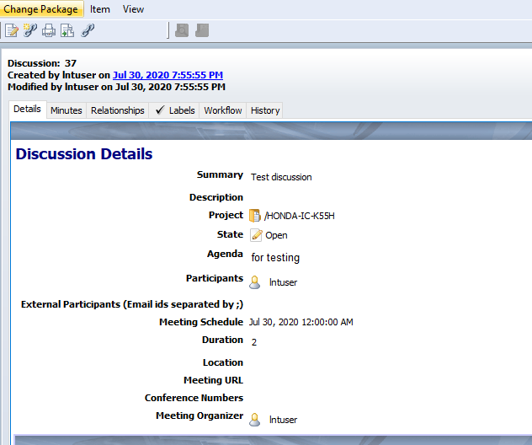
Creating a Discussion
Once user clicks on “Apply”, the Item Details view will appear as follows:
Steps:
1.Creating Discussion
2.Editing data in Item view
3.Applying changes in created item
4.Item Details View
5.Discussion Workflow

Slide 9
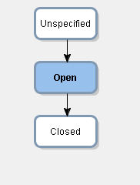
Creating a Discussion
The workflow will be as follows:
Steps:
1.Creating Discussion
2.Editing data in Item view
3.Applying changes in created item
4.Item Details View
5.Discussion Workflow

Slide 10
Discussion – Details Tab
The Details tab contains the following fields:
Summary: Short Title for the Discussion
Description: Brief introduction of the Discussion Item
Project: Project for which the Discussion will take place
State: State of the item based on workflow. (Default state selected will be “Open”)
Agenda: Points to be covered in the discussion with all details
Participants: Select participants (within Organization) for the Discussion
External Participants: Enter E-mails of Participants other than Organization separated by ‘;’ (semi-colon)
Meeting Schedule: Select date and time for Discussion from the Calendar
Duration: Mention Duration of Discussions in hours
Location: Mention Venue for Discussion
Meeting URL: Mention Meeting URL or link if the discussion is taking place online. (If Any)
Conference Numbers: Type Conference call numbers
Meeting Organizer: Select name of the person that has organized this meeting (it can be the user who creates the Discussion)

Slide 11
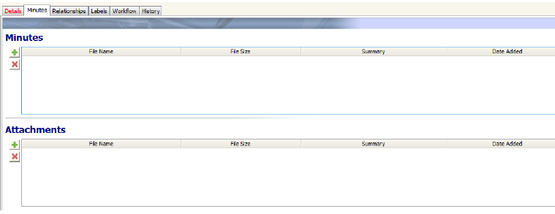
Discussion –Minutes Tab
Attachment tab avails users to add item related files to the Discussions:
₋Minutes–Attach MOMs
₋Customer Attachments –Related files discussed during discussions or that are part of discussion
Note: Attachments can be of any file format. It should not exceed the size of 5MB.

Slide 12
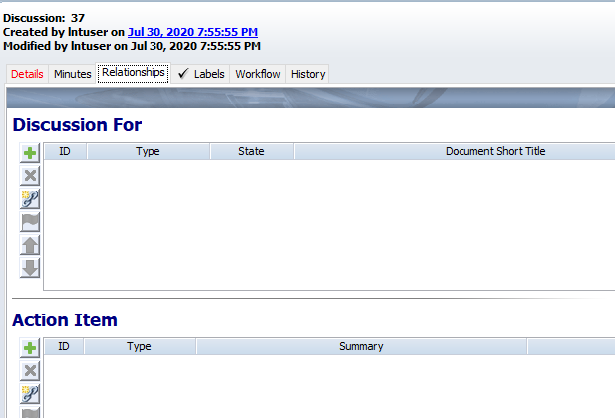
Discussion – Relationships Tab
The Relationships tab include the following fields:
Discussion For: User can attach Related item to this field for which the discussion is carried out.
  Also the user can create related item by clicking on symbol.
  Related items are Project, Test Plan, Defect and Product Release Plan.
Action Item: User can attach action items to this fields that are related to this discussion based on project.

Slide 13
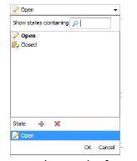
Closing the Discussion
Once the discussion is over, the Meeting Organizer is responsible to change the state to Closed.
To close the discussion:
  Edit the required Discussion by right clicking and select “Edit Item”.
  Change the state of the discussion from Open to Close.
  Changing the state to close will make the following fields mandatory before applying changes.
    Discussion Summary (Last field in Details Tab)
    Minutes(Attachment Tab)
  Fill the mandatory fields and click on “Apply” button.

Slide 14

Thank you
Thank you

